Slide 1
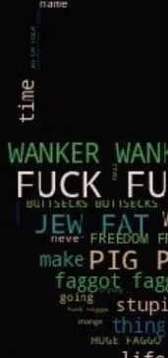

MALIGNANT COMMENTS CLASSIFIER PROJECT PRESENTATION
SUBMITTED BY : G. PREMSAGAR

Slide 2

INTRODUCTION
People may share their thoughts and communicate with others on social media platforms, which have been increasing for over a decade.
These arguments may emerge as a consequence of differences of opinion, and they frequently culminate in confrontations on social media, during which one side may use abusive language referred to as malignant remarks.
This definitely raises the risk of online harassment and abuse.
As a result, some people cease voicing their ideas or stop searching out various viewpoints, resulting in unhealthy and prejudiced debate.
As a result, many platforms and communities find it extremely difficult to allow fair dialogue, and are frequently obliged to either limit user comments or shut off user comments entirely.

Slide 3
PROBLEM STATEMENT
The proliferation of social media enables people to express their opinions widely online. However, at the same time, this has resulted in the emergence of conflict and hate, making online environments uninviting for users. Although researchers have found that hate is a problem across multiple platforms, there is a lack of models for online hate detection.
Online hate, described as abusive language, aggression, cyberbullying, hatefulness and many others has been identified as a major threat on online social media platforms. Social media platforms are the most prominent grounds for such toxic behavior.
There has been a remarkable increase in the cases of cyberbullying and trolls on various social media platforms. Many celebrities and influences are facing backlashes from people and have to come across hateful and offensive comments. This can take a toll on anyone and affect them mentally leading to depression, mental illness, self-hatred and suicidal thoughts.
Internet comments are bastions of hatred and vitriol. While online anonymity has provided a new outlet for aggression and hate speech, machine learning can be used to fight it. The problem we sought to solve was the tagging of internet comments that are aggressive towards other users. This means that insults to third parties such as celebrities will be tagged as unoffensive, but “u are an idiot” is clearly offensive.
Our goal is to build a prototype of online hate and abuse comment classifier which can used to classify hate and offensive comments so that it can be controlled and restricted from spreading hatred and cyberbullying.

Slide 4
DATASET DESCRIPTION
The data set includes a training set with roughly 1,59,000 samples and a test set with nearly 1,53,000 samples. 'Id', 'Comments', 'Malignant', 'Highly malignant', 'Rude', 'Threat', 'Abuse', and 'Loathe' are all fields found in all data samples. The label might be 0 or 1, with 0 indicating a NO and 1 indicating a YES. There are a number of comments with several labels. Each comment has a unique ID, which is the first property.
The data set includes:
Malignant: This is the Label column, which has values 0 and 1, indicating whether or not the comment is malignant.
Highly Malignant: Comments that are exceedingly malignant and damaging are referred to be "particularly malignant."
Rude: It refers to remarks that are obnoxious and rude.
Threat: It includes indications of words that are threatening to someone.
Abuse: It refers to statements that are abusive.
Loathe: Hateful and loathing comments are described as hateful and loathing comments.
ID: It contains unique identifiers for each comment content.
Comment text: This column comprises the extracted remarks from various social media networks.

Slide 5
CONCEPTUAL BACKGROUND OF THE DOMAIN PROBLEM
Online platforms and social media have evolved into places where individuals may freely discuss their beliefs without regard for race, and where people can share their thoughts and ideas with a large group of people.
Through the creation of virtual networks and communities, social media is a computer-based technology that allows the exchange of ideas, opinions, and information. Social media is Internet-based by design, allowing people to share material quickly via electronic means. Personal information, documents, movies, and images are all included in the content. Users interact with social media using web- based software or applications on a computer, tablet, or smartphone.
While social media is widely used in the United States and Europe, Asian nations such as India are at the top of the list. Social media is used by about 3.8 billion people.
Some people or a motivated mob on this massive internet platform or online community wilfully abuse others to prevent them from sharing their thoughts in a proper manner. They use filthy language to intimidate others, which is considered a form of ignominy in civilised society. When innocent people are intimidated by these mobs, they remain mute without saying anything. As a result, the disgusting mob's goal is excellently realised.
To address this issue, we are now developing a model that recognises all foul language and foul terms, with the goal of preventing these mobs from using foul language in online communities or perhaps blocking them from using foul language altogether.

Slide 6
MULTILABEL VS MULTICLASS CLASSIFICATION
Because the goal was to determine if the data belonged to zero, one, or more than one of the six categories in our dataset, the first step was to distinguish between multi-label and multi-class classification.
We have one essential assumption in multi-class classification: our data can only correspond to one label out of all the labels we have. A given picture of a fruit, for example, could only be an apple, orange, or guava, and not a mix of these.
Data can be assigned to many labels at the same time in multi-label categorization. In our instance, for example, a comment may be poisonous, lewd, and disrespectful all at the same time. It's also possible that the comment isn't harmful and hence doesn't fit into any of the six categories.
As a result, I was faced with a multi-label categorization challenge. The next step was to use data to acquire some important insights that would help with future problem solving.

Slide 7
DATA SCIENCE LIFE CYCLE
Data Cleaning
Import the collected data from web scraping
Exploratory Data Analysis
Check through all the dataset information like datatype, missing value, duplicate value etc.
Visualization and Data Preprocessing
Use various visualization methods to check the data distribution identify presence of outliers and skewness
Clean and format the records as per usage by using various imputation techniques
Analyze each and every data record to ensure we have usable information
Perform encoding and scaling methods

Slide 8
DATA SCIENCE LIFE CYCLE
Model Building
Create appropriate Regression Machine Learning model function.
Model Evaluation
Usage of evaluation metrics to check the accuracy of the models over trained and test data inputs.
Hyperparameter Tuning Best Model
Choosing the appropriate Regression Machine Learning model to check various parameter permutation and combinations.
Need to ensure that whenever the regression function is called it is able to process all the necessary parameters
Ensure the cross validation techniques helps in reducing over fitting and under fitting data
Using Grid Search CV to obtain the best parameters that can be plugged into the selected model

Slide 9
MODEL BUILDING STEPS
Data Cleaning
Exploratory Data Analysis
Data Pre-processing
Model Building
Model Evaluation
Selecting the best model
1
2
3
4
5
6

Slide 10
DATA PREPROCESSING
1. Load dataset.
2. Remove null values.
3. Drop column id.
4. Convert comment text to lower case and replace '\n' with single space.
5. Keep only text data ie. a-z' and remove other data from comment text.
6. Remove stop words and punctuations.
7. Apply Stemming using SnowballSt.mmer
8. Convert text to vectors using TfidfVectorizer
9. Load saved or serialized model
10. Predict values for multi class label

Slide 11
TECHNOLOGY USED
HARDWARE TECHNOLOGY BEING USED:
CPU : MacBook Pro, M1 Chipset
RAM :8GB
GPU : 8GB
SOFTWARE TECHNOLOGY BEING USED: Programming language : Python Distribution : Anaconda Navigator
Browser based language shell : Jupyter Notebook
LIBRARIES/PACKAGES SPECIFICALLY BEING USED: Pandas, NumPy, Matplotlib, Seaborn, Scikit-learn, Pandas-profiling, Missingno, NLTK.

Slide 12
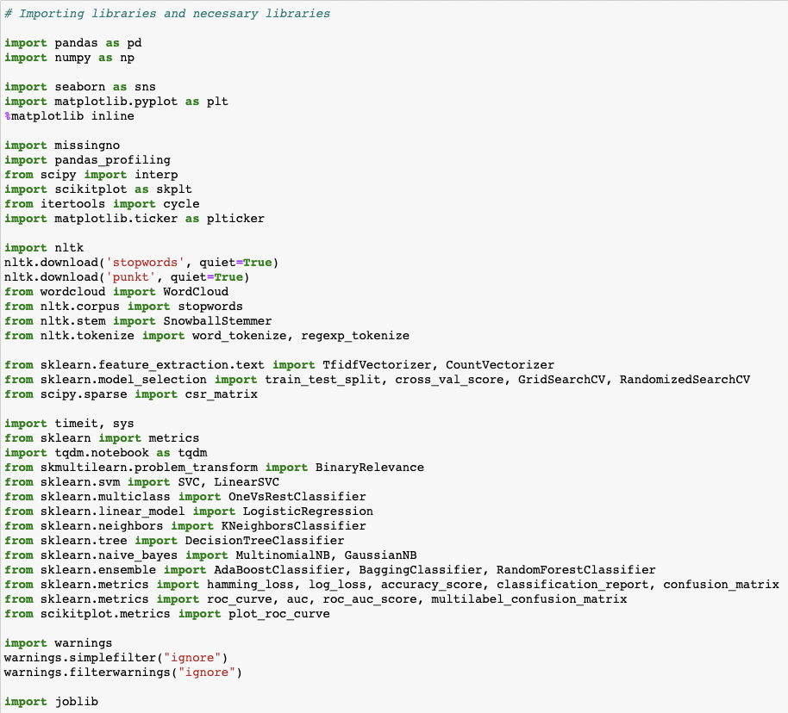
IMPORTED DEPENDENCIES

Slide 13
EXPLORATORY DATA ANALYSIS (EDA) & VISUALIZATION
01. Univariate Analysis
Univariate analysis is the simplest form of analyzing data. “Uni” means “one”, so in other words your data has only one variable.
02. Multivariate Analysis
Multivariate analysis is a set of statistical techniques used for analysis of data that contain more than one variable.
03. Correlation of Dataset
Correlation is used to test relationships between quantitative variables or categorical variables.
04. Correlation with Target variable
05. Conclusion
Correlation with the target variable to know how the data is related.
Summary with the conclusion of all the analysis

Slide 14
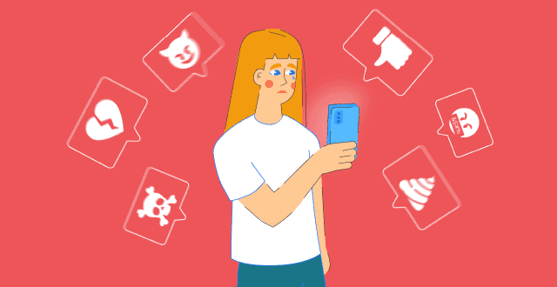
CYBERBULLYING STATISTICS
Cyberbullying has become a growing problem in countries around the world. Essentially, cyberbullying doesn’t differ much from the type of bullying that many children have unfortunately grown accustomed to in school. The only difference is that it takes place online.

Slide 15
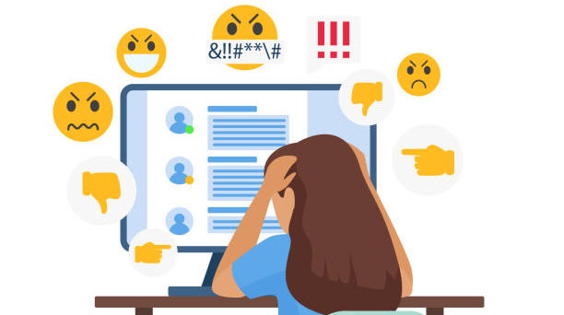
EFFECTS OF CYBERBULLYING
Cyberbullying is a very serious issue affecting not just the young victims, but also the victims' families, the bully, and those who witness instances of cyberbullying. However, the effect of cyberbullying can be most detrimental to the victim, of course, as they may experience a number of emotional issues that affect their social and academic performance as well as their overall mental health.

Slide 16
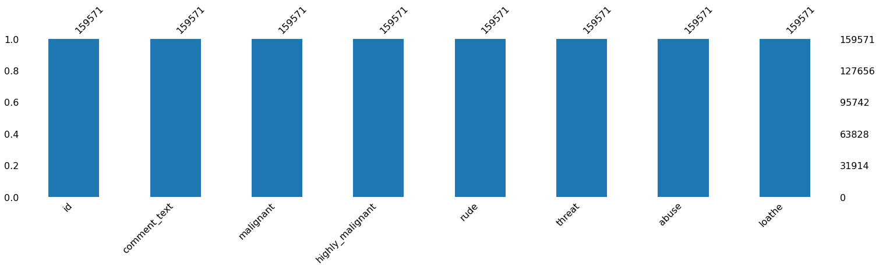
MISSING VALUES

Slide 17
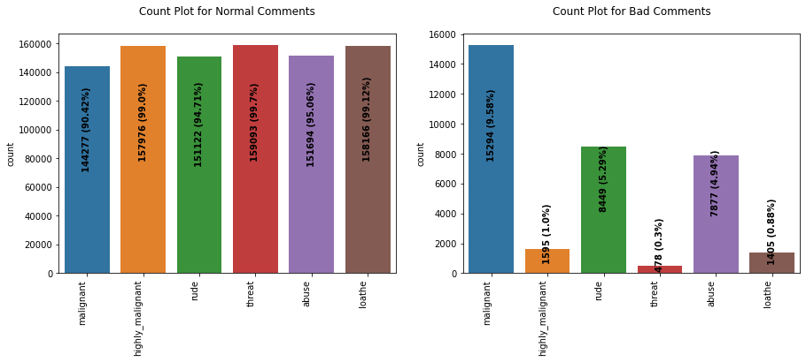
COUNT PLOT

Slide 18
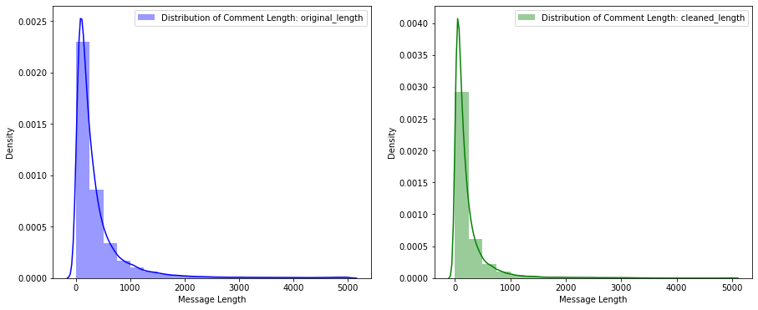
DISTRIBUTION PLOT

Slide 19
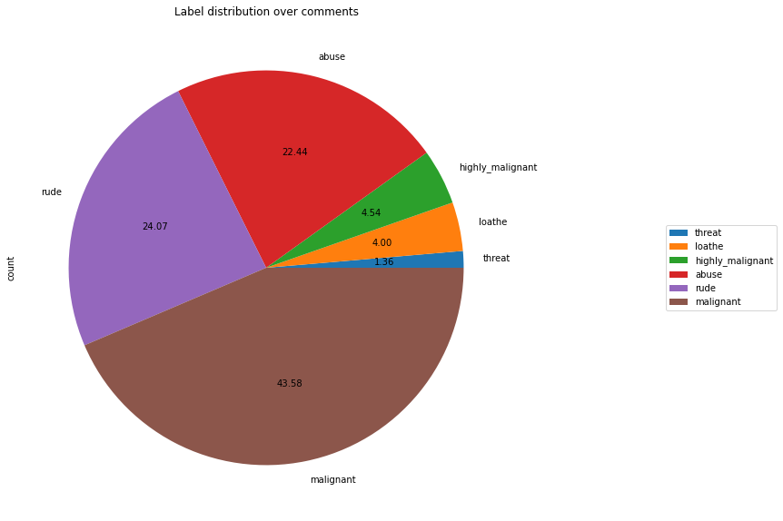
PIE PLOT

Slide 20
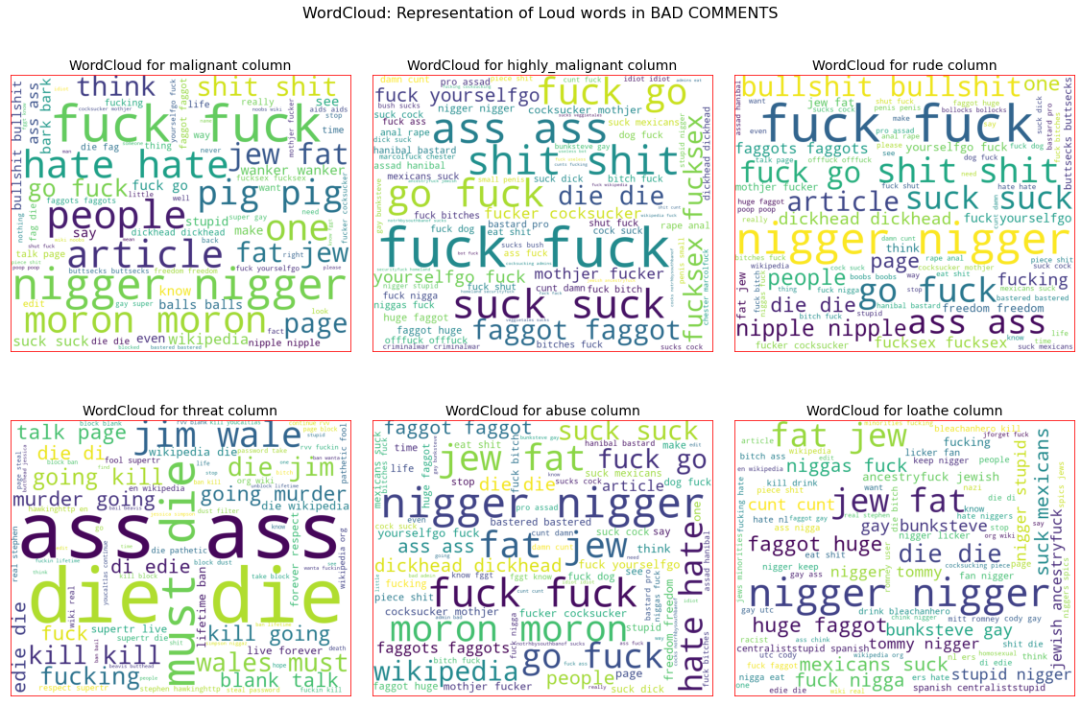
WORD CLOUD

Slide 21
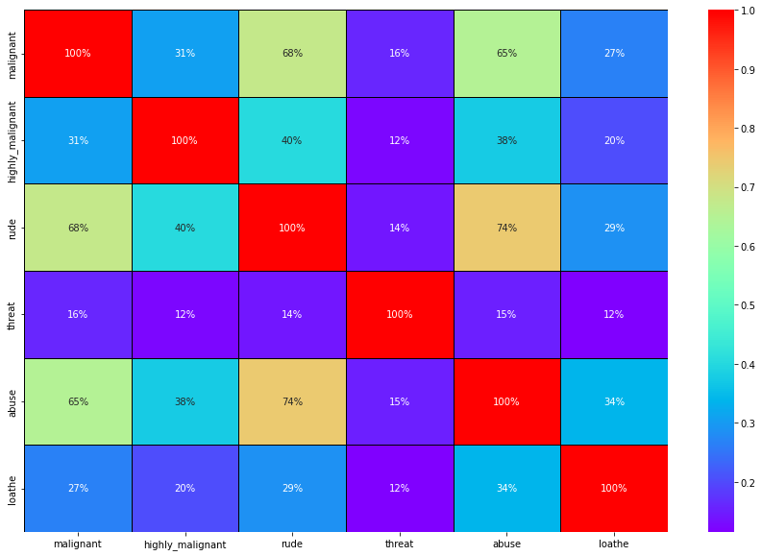
HEAT MAP

Slide 22
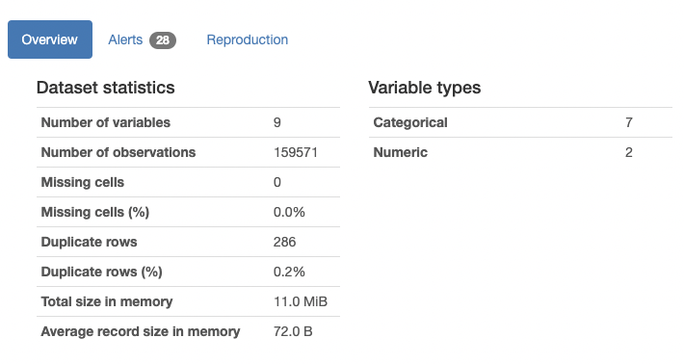
PANDAS PROFILING

Slide 23
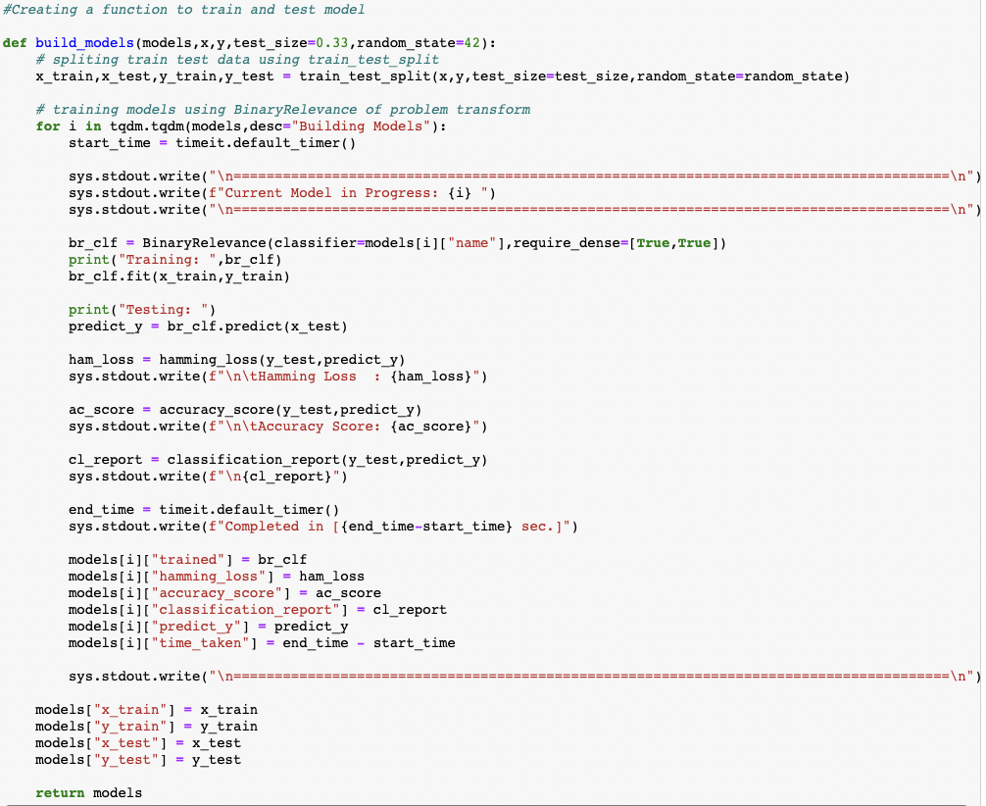
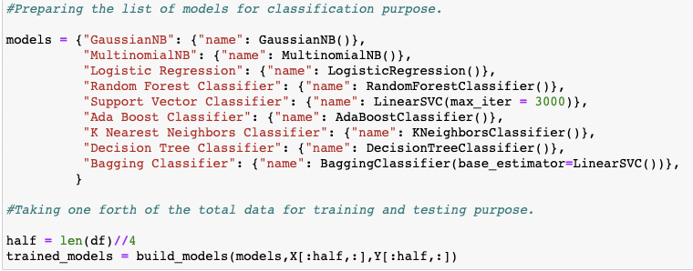
CLASSIFICATION FUNCTION

Slide 24
CLASSIFICATION MACHINE LEARNING MODELS

Slide 25
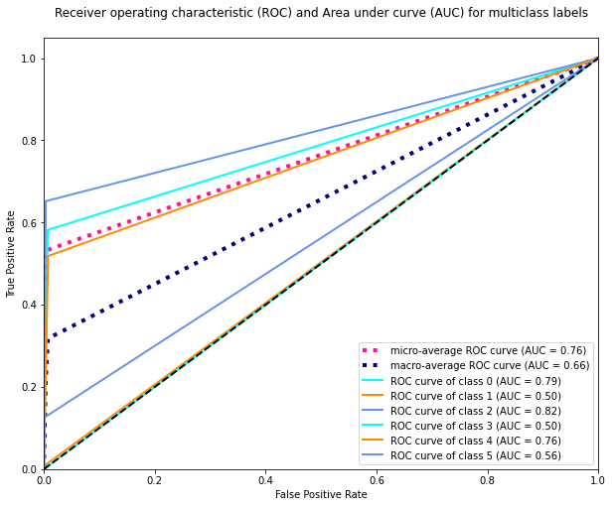
ROC AUC CURVE

Slide 26
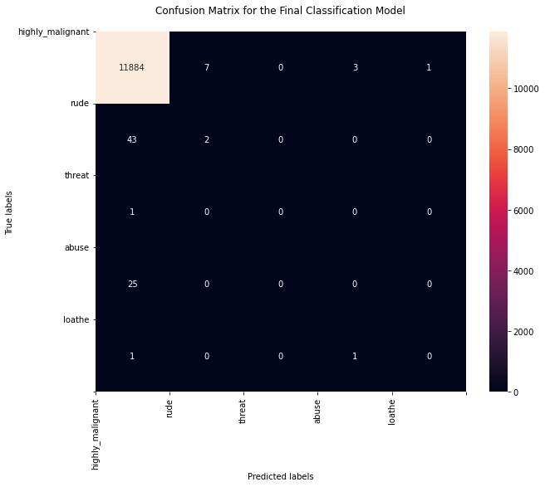
CONFUSION MATRIX

Slide 27
KEY FINDINGS AND CONCLUSIONS OF THE STUDY
The survey discovered that just a small percentage of online users use unparliamentary language. And the majority of these phrases contain a lot of stop words and are pretty lengthy. As previously said, a few motivated rude mobs use harsh language in internet forums to harass individuals and prevent them from doing what they are not permitted to do. Our research aids online forums and social media in enforcing a prohibition on swearing or the use of profanity on these platforms.

Slide 28
LEARNING OUTCOMES OF THE STUDY IN RESPECT OF DATA SCIENCE
We learned several natural language processing techniques through this research, such as lemmatization, stemming, and stop word elimination. Through the hash vectorizer, we were also able to learn how to turn strings into vectors. We used a variety of assessment criteria in this research, including log loss, hamming loss, and accuracy.
My project's conclusion is that we should use good, courteous language on social media and avoid using abusive, vulgar, and derogatory terms.
It has the potential to produce a slew of issues that will have an impact on our life.
When dealing with tension and negativity, try to be courteous, cool, and collected; one of the greatest solutions is to ignore it and overcome it in a constructive way.

Slide 29
LIMITATIONS OF THIS WORK AND SCOPE FOR FUTURE WORK
PROBLEMS FACED WHILE WORKING IN THIS PROJECT:
Because it took more than 2 hours, extra computer power was necessary.
The dataset is unbalanced, and the comment messages are poorly written.
Because time was used more, good parameters could not be acquired through hyper-parameter tweaking.
AREAS OF IMPROVEMENT:
Could be given a solid dataset that doesn't take too long .
Time complexity is reduced.
Creating a well-balanced dataset with fewer mistakes.

Slide 30
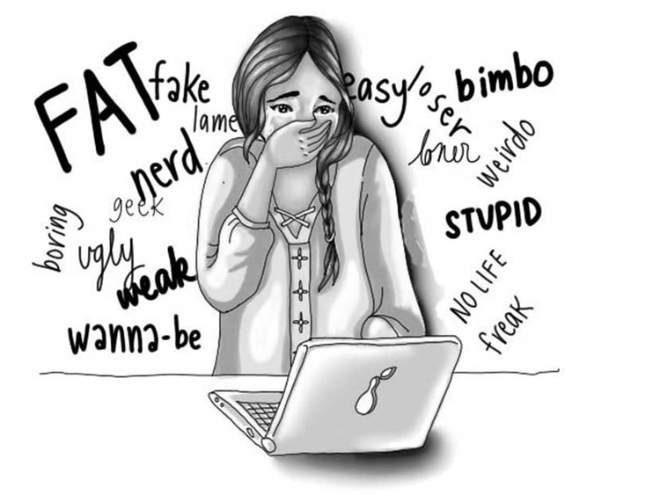
Thank You

